Slide 1
IDS and IPS
.
MTT06105: | FUNDAMENTALS OF IT SECURITY

Slide 2
Intrusion Detection System (IDS)
An Intrusion Detection System (IDS) is a hardware/software combination or a combination of both hardware and software that detects the intrusions into a system or network.
An intrusion detection system (IDS) is software that automates the intrusion detection process.
Intrusion Detection Systems (IDS) analyze network traffic for signatures that match known cyber attacks.
Intrusion Detection Systems (IDS): analyze and monitor network traffic for signs that indicate attackers are using a known cyberthreat to infiltrate or steal data from your network

Slide 3
Intrusion Detection System (IDS)
IDS systems compare the current network activity to a known threat database to detect several kinds of behaviors like security policy violations, malware, and port scanners.
IDS complements a firewall by providing a thorough inspection of both the packets’ header and its contents thus protecting against attacks.
IDS inspect each and every packet’s content traversing the network to detect any malicious activity.

Slide 4
Types of IDS
Host-based IDS:
Protects the end system or the network resources.
Network-based IDS:
Monitors network traffic for attacks. A Network IDS is deployed on the network near a firewall, on the DMZ or even inside the trusted internal network.

Slide 5
Why Use IDS?
Why use IDS?
The answer is very simple: We do not want somebody to enter our system with malicious intentions and carry out attacks on our systems, thereby endangering our whole network.
We want to be alerted of any such activities so that we can act upon such incidents immediately and take actions to eliminate the root causes of such issues and eliminate any potential damages/disruptions caused by them.

Slide 6
IDS/IPS technology
True Positives: These are alerts that something is not right when it is actually not right. Example: The IDS finds a packet as containing malicious code and it was actually true that the packet had malicious code, as confirmed by investigation.
True Negatives: These are alerts that something is right when it is actually right. Example: The IDS finds a packet as containing no issues and it actually had no issues.

Slide 7
IDS/IPS technology
False Positives: These are alerts indicating that something is not right with a packet when actually it is right. Example: The IDS finds a packet as having malicious code but it is actually a genuine code.
False Negatives: These are alerts that something is right when actually it is wrong. Example: The IDS finds that a packet does not have any malicious code but it actually does contain a malicious code, as found through investigation.

Slide 8
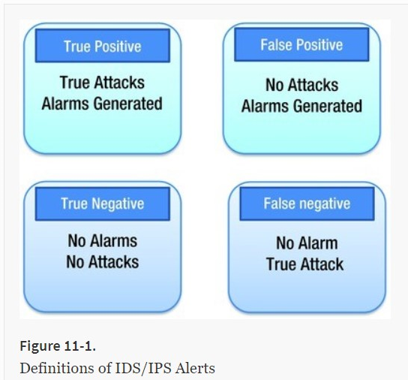
IDS/IPS technology

Slide 9
Intrusion Prevention System (IPS)
An intrusion prevention system (IPS) is a form of network security that works to detect and prevent identified threats.
An Intrusion Prevention System (IPS) is used to prevent the intrusion.
Intrusion prevention systems continuously monitor your network, looking for possible malicious incidents and capturing information about them.
The IPS reports these events to system administrators and takes preventative action, such as closing access points and configuring firewalls to prevent future attacks.

Slide 10
Intrusion Prevention System (IPS)
Intrusion Prevention Systems (IPS): live in the same area of the network as a firewall, between the outside world and the internal network.
IPS proactively deny network traffic based on a security profile if that packet represents a known security threat.

Slide 11
Intrusion Prevention System (IPS)
IPS solutions can also be used to identify issues with corporate security policies, deterring employees and network guests from violating the rules these policies contain.
With so many access points present on a typical business network, it is essential that you have a way to monitor for signs of potential violations, incidents and imminent threats.

Slide 12
How Do Intrusion Prevention Systems Work?
Intrusion prevention systems work by scanning all network traffic.
There are a number of different threats that an IPS is designed to prevent, including:
Denial of Service (DoS) attack
Distributed Denial of Service (DDoS) attack
Various types of exploits
Worms
Viruses
The IPS performs real-time packet inspection, deeply inspecting every packet that travels across the network

Slide 13
How Do Intrusion Prevention Systems Work?
If any malicious or suspicious packets are detected, the IPS will carry out one of the following actions:
Terminate the TCP session that has been exploited and block the offending source IP address or user account from accessing any application, target hosts or other network resources unethically.
Reprogram or reconfigure the firewall to prevent a similar attack occurring in the future.
Remove or replace any malicious content that remains on the network following an attack

Slide 14
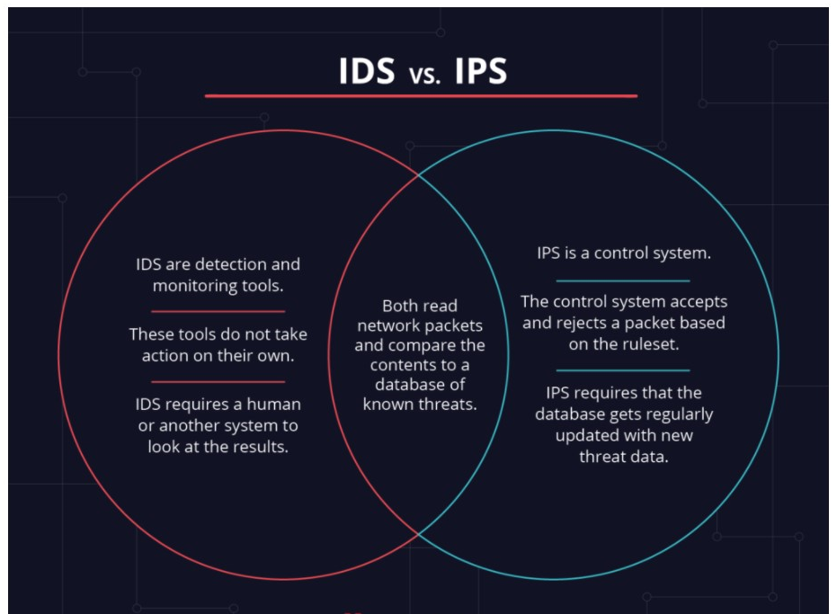
The Differences Between IDS and IPS

Slide 15
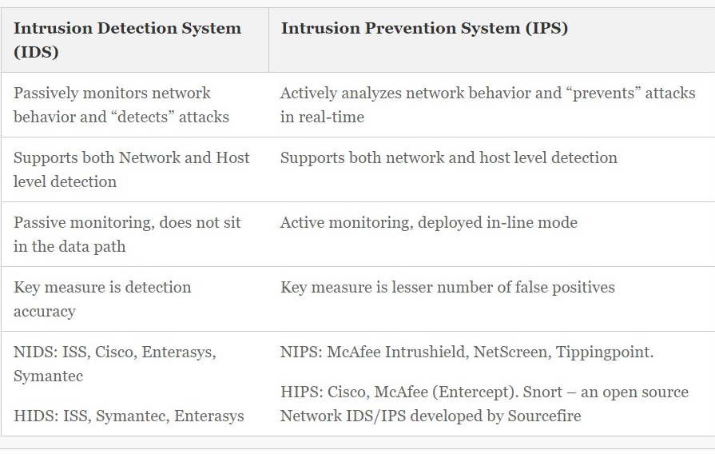
The Differences Between IDS and IPS

Slide 16
The Differences Between IDS and IPS
Intrusion Detection Systems (IDS) analyze network traffic for signatures that match known cyber attacks. Intrusion Prevention Systems (IPS) also analyzes packets, but can also stop the packet from being delivered based on what kind of attacks it detects — helping stop the attack.

Slide 17
How Does Detection Work?
The Intrusion Detection and Prevention Systems detect intrusions through the following mechanisms:
signature-based detection
anomaly-based detection
stateful protocol analysis.

Slide 18
How Does Detection Work?
Signature-Based Detection
This mechanism protects against known threats. A signature is a known pattern of a threat, such as:
An e-mail with an attachment containing a known malware with an interesting subject (for example, an e-mail with the subject “I love you”).
A “remote login” by an admin user, which is a clear violation of an organization’s policy.

Slide 19
How Does Detection Work?
Anomaly-Based Detection
An “anomaly” is anything that is abnormal. If any traffic is found to be abnormal from the baseline, then an alert is triggered by the IDS suspected of an intrusion.
DPS first creates a baseline profile that represents the normal behavior of the traffic.
The baseline profile is created by allowing the IDS system to learn the traffic over a period of time so that IDPS can study the traffic behavior during peak hours, non-peak hours, night hours, early hours of business, and as per your organizational network behavior.

Slide 20
How Does Detection Work?
Stateful Protocol Analysis Detection
This method is similar to the anomaly-based detection, except that the profiles are created by the vendors who supply the sensor equipment (IDPS)
The profiles are predetermined and made up of the generally accepted benign network traffic activity as specified by the standards.

Slide 21
How Does Detection Work?
Stateful Protocol Analysis Detection
“Stateful” means that the IDPS has the capability to keep track of the state of the protocol both in network layer and application layers.
For example, in case of a TCP connection establishment state, the IDS should remember all the connection states.

